Slide 1


Bank Loan Project & Analysis Report using SQL & PowerBI

Slide 2
Bank Loan Dataset
Bank dataset deals with granting loans to the employees based on different conditions.
It consists of the following columns: Emp_id, State, Home_Ownership, Issue_Date, Loan_Status, Purpose, term, Instalment, Int_rate, Loan_amount, Total_payment, etc.
Factors affecting the loan acceptance decision
Person’s Income: A higher income increases the likelihood of receiving a loan.
Regional Area: Living place increase trust level to provide loan.
Employment Status: Employed person has good chance to loan approval.
Annual Income: Annual Income reflects the borrower's total yearly earnings. It assesses repayment capacity.

Slide 3
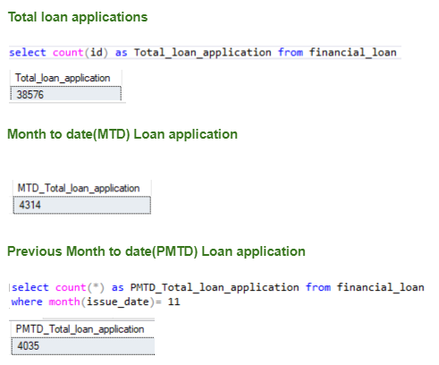
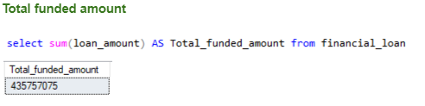
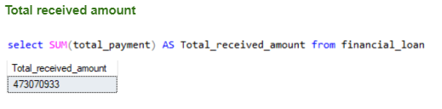
Writing queries in SSMS(SQL Server management system)

Slide 4


Connecting SSMS to PowerBI
Get Data from SQL Server:
In Power BI Desktop, click on Home > Get Data > SQL Server.
In the SQL Server database window, enter the Server name and Database name.
Choose the Import Data Connectivity mode .
Click OK.

Slide 5
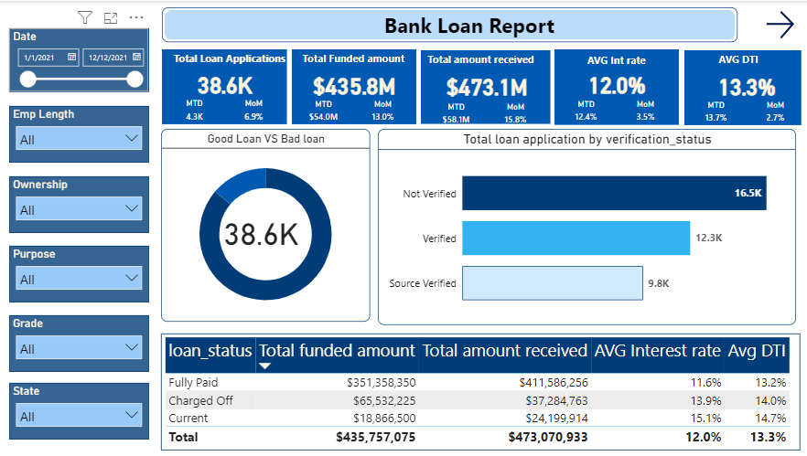

Slide 6
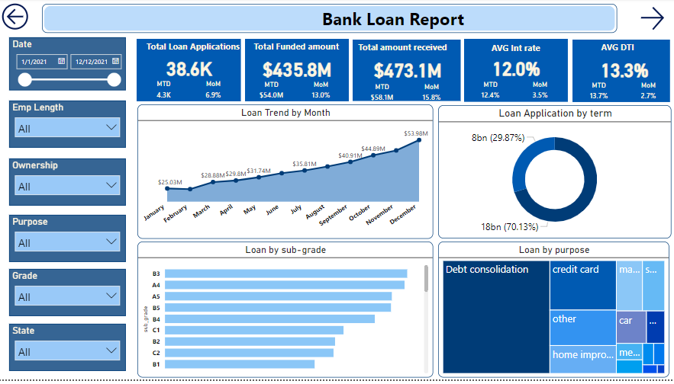

Slide 7
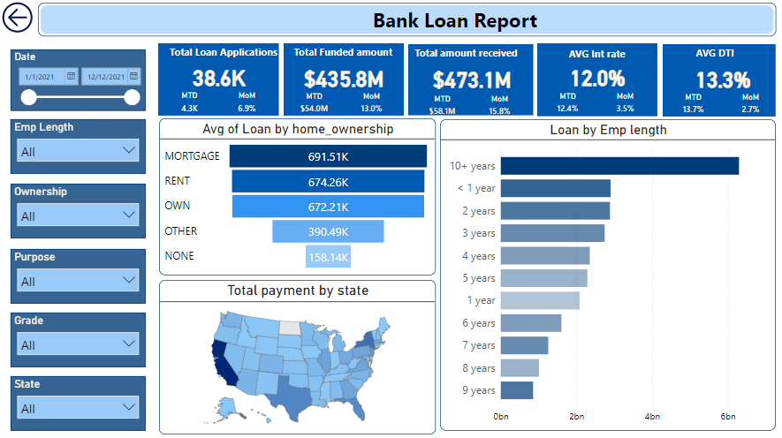

Slide 8
Calculated Measures
Created the Date Table:
Date Table = CALENDAR(MIN(financial_loan[issue_date]), MAX(financial_loan[issue_date]))
Total loan application = CALCULATE(COUNT(financial_loan[id]))
MTD loan applications = CALCULATE(TOTALMTD([Total loan application],'Date Table'[Date]))
PMTD loan applications = CALCULATE([Total loan application],DATESMTD(DATEADD('Date Table'[Date],-1,MONTH)))
MoM loan application = ([MTD loan applications]-[PMTD loan applications])/[PMTD loan applications]
Total funded amount = SUM(financial_loan[loan_amount])
MTD funded amount = CALCULATE(TOTALMTD([Total funded amount],'Date Table'[Date]))
PMTD funded amount = CALCULATE([Total funded amount],DATESMTD(DATEADD('Date Table'[Date],-1,MONTH)))
MoM funded amount = ([MTD funded amount]-[PMTD funded amount])/[PMTD funded amount]

Slide 9
Total amount received = SUM(financial_loan[total_payment])
MTD amount received = CALCULATE(TOTALMTD([Total amount received],'Date Table'[Date]))
PMTD amount received = CALCULATE([Total amount received],DATESMTD(DATEADD('Date Table'[Date],-1,MONTH)))
MoM amount received = ([MTD amount received]-[PMTD amount received])/[PMTD amount received]
Avg DTI = AVERAGE(financial_loan[dti])
AVG Interest rate = CALCULATE(AVERAGE(financial_loan[int_rate]))
Bad laon = CALCULATE(COUNTROWS(financial_loan),financial_loan[loan_status] = "Charged Off")
Good loan = CALCULATE(COUNTROWS(financial_loan),OR (financial_loan[loan_status]="Fully Paid", (financial_loan[loan_status]="Current")))

Slide 10
Key Performance indicators (KPI’s)
Total Loan Applications: Used to track the total number of loan applications received, to monitor the Month-to-Date (MTD) Loan Applications and track changes Month-over-Month (MoM).
Total Funded Amount: Used to track the total amount funded by the loan to the borrower, to monitor the Month-to-Date (MTD) funded amount and track changes Month-over-Month (MoM).
Total Amount Received: Used to track the total amount received by the bank after all the installments are made by the borrower, to monitor the Month-to-Date (MTD) amount received and track changes Month-over-Month (MoM).
AVG INT Rate: Used to calculate the Average Interest rate, to monitor the Month-to-Date (MTD) amount received and track changes Month-over-Month (MoM).
AVG DTI: Used to calculate the Average Debt to Income (DTI) ratio for the borrowers, which is used to calculate the borrowing risk. Low DTI ratio: Indicates the borrower’s debts and income are balanced. High DTI ratio: Indicates that borrower too much of debts for the income. Hence, will not be able to maintain the payment.

Slide 11
Conclusion
The objective of a bank loan Power BI report is to provide insights into a bank's loan portfolio performance and lending activities.
The report can help banks make data-driven decisions, identify trends, and improve their credit and loan offerings.
Support strategic decision-making: Enhance the bank's credit and loan offerings to meet market demands and customer needs.

